Slide 1
DESIGN OF SURVIVABLE NETWORKS:
POLYHEDRAL TECHNIQUES
A. Ridha Mahjoub
LIMOS, Université Blaise Pascal, Clermont-Ferrand

Slide 2
Contents
Polyhedral techniques
1.1. Polyhedral Approach
1.2. Separation and Optimization
1.3. Cutting plane method
1.4. Branch&Cut
2. Design of Survivable Networks

Slide 3
Polyhedral Techniques
1.1. Polyhedral Approach
1.1. Polyhedral Approach
A Combinatorial Optimization (C.O.) problem is a problem of the form
P=max{c(F)=Σ_{e∈F} c(e), F ∈ F}
where F is the set of solutions of P,
F ⊂ 2E for a set ground set E and c(F) is the weignt of F.
With F ∈ F, we associate a {0,1} vector x^{F} ∈ R^{E} , called the incidence vector of F given by
{
if i ∈ F
0 if i ∈ E\F
x^{F}_{i}=

Slide 4

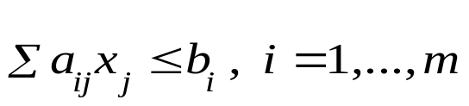
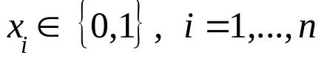
Polyhedral Techniques
1.1. Polyhedral Approach
A C.O. problem can be formulated as a 0-1 program.
Idea : Reducing the problem to a linear program.
Subject to:
Solutions of P (S)
P(P)=convex hull of S
0-1 Program

Slide 5

Polyhedral Techniques
1.1. Polyhedral Approach
A C.O. problem can be formulated as a 0-1 program.
Idea : Reducing the problem to a linear program.
Subject to:
New Constraints
P(P)=convex hull of S
x_{i}≥ 0, i=1,…,n
Linear Program
P ⇔ max{cx, x ∈P(P)}

Slide 6
Polyhedral Techniques
1.1. Polyhedral Approach
Polyhedral Approach:
Let P be a C.O. on a ground set E, |E|=n.
1. Represent the solutions of P as 0-1 vectors.
2. Consider these vectors as points of R^{n}, and define
the convex hull P(P) of these points.
3. Characterize P(P) by a linear inequality system.
4. Apply linear programming for solving the problem.
This approach has been initiated by Edmonds in 1965 for
the Matching Problem.
Step 3. is the most difficult.

Slide 7
Polyhedral Techniques
1.1. Polyhedral Approach
If the problem is polynomial, generally it is possible to characterize
the associated polytope!
If the problem is NP-complete, there is a very little hope to get such
a description.
Question: How to solve the problem when it is NP-complete.

Slide 8
Polyhedral Techniques
1.1. Polyhedral Approach
A further difficulty:
The number of (necessary) constraints may be exponentail.
The Traveling Salesman Problem
For 120 cities,
The number of (necessary) contraints is ≥10¹⁷⁹
(≅ 10¹⁰⁰ times the number of atoms in the globe)
(number of variables: 7140.)
To solve the TSP on 120 cities,
(Grötschel 1977), used only 96 contraints among the 10¹⁷⁹
known constraints..

Slide 9
Polyhedral Techniques
1.2. Separation and Optimization
1.2. Separation and Optimization
With a linear system
Ax≤ b
we associate the following problem:
Given a solution x*, verify whether x* satisfies Ax≤ b,
and if not, determine a constraint of Ax≤ b which is violated by x*.
This problem is called the separation problem associated with Ax≤ b.

Slide 10
Polyhedral Techniques
1.2. Separation and Optimization
If x* does not verify system Ax≤ b, then there is a hyperplane that separates x* and the polyhedron Ax≤ b.
x*
Ax≤ b
Hyperplane separating x*
And the polyhedron Ax≤ b.

Slide 11
Polyhedral Techniques
1.2. Separation and Optimization
Theorem: (Grötschel, Lovász, Schrijver, 1981)
Given a linear program
P=max{cx, Ax≤ b},
there is a polynomial time algorithm for P if and only if there is a
polynomial time algorithm for the separation problem associated with Ax≤ b.

Slide 12
Polyhedral Techniques
1.3. Cutting plane method
P(P)

Slide 13




Polyhedral Techniques
1.3. Cutting plane method
P(P)

Slide 14

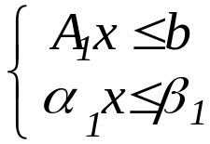


Polyhedral Techniques
1.3. Cutting plane method
P(P)

Slide 15
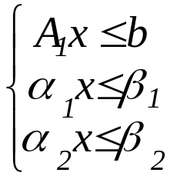

Polyhedral Techniques
1.3. Cutting plane method
P(P)

Slide 16


Polyhedral Techniques
1.3. Cutting plane method
P(P)

Slide 17
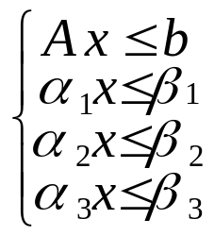
Polyhedral Techniques
1.3. Cutting plane method
P(P)

Slide 18
Polyhedral Techniques
1.4. Branch&Cut
1.4. Branch&Cut Method
- A Branch&Bound based method.
- On each node of the tree we solve a linear relaxation of the problem by the cutting plane method.
1) If an optimal solution in not still found, select a (pending) node of
the tree and a fractional varaiable x_{i}. Consider two sub-problems
by fixing x_{i} to 1 and x_{i} to 0 (branching phase).
2) Solve each sub-problem by generating new violated constraints
(cutting phase).
Go to 1).

Slide 19
Polyhedral Techniques
1.4. Branch&Cut
Remarks:
The polyhedral approach (Branch&Cut) is powerful for solving NP-hard C.O. problems. It also permits to prove polynomiality.
- Generally, it is difficult to find polynomial time separation algorithms. Then separation heuristics could be efficient in this case.
If there is a huge number of variables, one can combine a Branch&Cut algorithm with a column generation method (Branch-and-Cut-and-Price).
frequency assignment
vehicule routing

Slide 20
Contents
Polyhedral techniques
1.1. Introduction
1.2. Polyhedral Approach
1.3. Separation and Optimization
1.4. Cutting plane method
1.5. Branch&Cut
2. Design of Survivable Networks

Slide 21
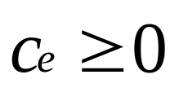
2. Network survivability
Offices
type 0 (optional)
type 1 (ordinary)
type 2 (special)
Links

Slide 22
2. Network survivability
Offices
type 0 (optional)
type 1 (ordinary)
type 2 (special)
Links

Slide 23
2. Network survivability
Offices
type 0 (optional)
type 1 (ordinary)
type 2 (special)
Links

Slide 24
2. Network survivability
Offices
type 0 (optional)
type 1 (ordinary)
type 2 (special)
Links

Slide 25
2. Network survivability
Failure
type 0 (optional)
type 1 (ordinary)
type 2 (special)

Slide 26
2. Network survivability
Survivability
The ability to restore network service in the event of a catastrophic failure.
Goal
Satisfy some connectivity requirements in the network.
Motivation
Design of optical communication networks.

Slide 27
Contents
Design of Survivable Networks
2.1. A general model
2.2. Heuristics
2.3. Polyhedral results
2.4. Separation
2.5. Critical extreme points
2.6. A Branch&Cut algorithm
2.7. Survivability with bounded length
2.8. Capacitated survivable networks

Slide 28
2. Network survivability
2.1. General model
2.1. A General model
A first model
Given an undirected graph G=(V,E) with
a weight on each edge,
a nonnegative integer matrix R=(r_{ij}) of connectivity requirements,
find a minimum weight subgraph of G such that between every pair of nodes i, j of V, there are at least r_{ij} edge (node)-disjoint paths
Frish (1967), Steiglitz (1969)
Chou and Frank (1970)
Winter (1985), Grötschel, Monma (1990)

Slide 29
2. Network survivability
2.1. General model
A practical model: node types
Let G=(V,E) be a graph. If s is a node of G, we associate with s a connectivity type r(s)∈N.
If s,t are two nodes, let
r(s,t)=min(r(s),r(t))
G is said to be survivable if for every pair of nodes s,t, there are at least r(s,t) edge (node)-disjoint paths between s and t.
(Grötschel, Monma, Stoer (1992))

Slide 30
2. Network survivability
2.1. General model
The Survivable Network Design Problem (SNDP)
Given weights on the edges of G, find a minimum weight survivable subgraph of G.
The SNDP is also known as the generalized Steiner tree problem
and the multiterminal synthesis problem.

Slide 31
2. Network survivability
2.1. General model
Special cases:
- r(v)=1 for every v: the minimum spanning tree problem.
- r(v)=1 for two nodes s,t and 0 elsewhere: the shortest path problem
between s and t.
- r(v)∈{0,1} for every v: the Steiner tree problem.
- r(v)=k for every v (k fixed): the k-edge (k-node) connected subgraph
problem .
The SNDP is NP-hard in general.

Slide 32
2. Network survivability
2.1. General model
Polynomially solvable cases
c(e)=c for all e (uniform costs): (Chou and Franck (1970))
Given a set of nodes V, construct a minimum weight graph on V satisfying the (edge) connectivity requirements (parallel edges are allowed).
c(e)=0/1 for all e: The augmentation problem (edge case)
(parallel edges are allowed): (Franck) (1992)).
Polynomial time algorithms have also been devised for
special classes of graphs (like series-parallel graphs)
special types of node connectivities

Slide 33
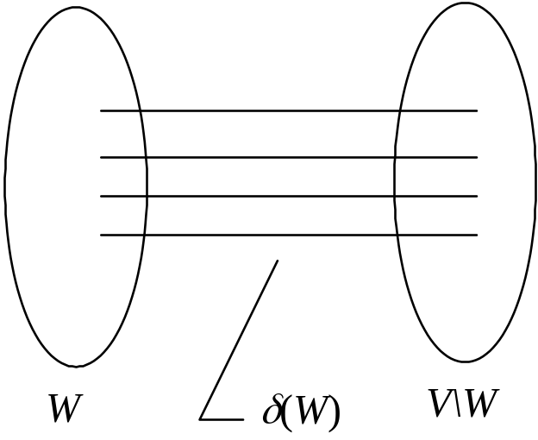
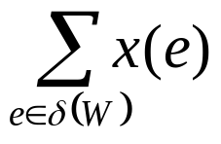
2. Network survivability
2.1. General model
Formulation of the SNDP (edge case)
If W⊂V, ∅ ≠ W≠V , let
r(W)=max{r(s) | s∈W}
con(W)=min{r(W), r(V\W)}
r(W) is the connectivity type
of W.
δ(W) is called a cut of G.
= x(δ(W))≥con(W)
cut inequalities

Slide 34
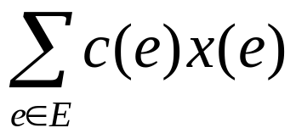
2. Network survivability
2.1. General model
The (edge) SNDP is equivalent to the following integer program
min
Subject to
x(δ(W))≥con(W) for all W⊂V, ∅ ≠ W≠V
0≤x(e)≤1 for all e ∈ E,
x(e)∈{0,1} for all e ∈ E.
Follows from Menger’s theorem (1927).

Slide 35
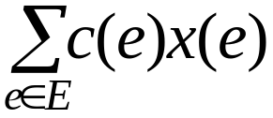
2. Network survivability
2.1. General model
min
min
Subject to
Subject to
x(δ(W))≥con(W) for all W⊂V, ∅ ≠ W≠V
0≤x(e)≤1 for all e ∈ E,
The linear relaxation can be solved in polynomial time (by the
ellipsoid method).

Slide 36
2. Network survivability
2.2. Heuristics
2.2. Heuristics
Steiglitz, Weiner and Kleitman (1969): (general case):
Local search heuristic
Monma & Shallcross (1989): (r(v) ∈{1,2} for all v):
based on heuristics for the traveling salesman problem
Ko & Monma (1989): (r(v)=k for all v) (The k-edge (node) connected
subgraph problem): extension of Monma & Shallcross heuristic.

Slide 37
2. Network survivability
2.2. Heuristics
Heuristics with worst case garantee
A function f: 2^{V} Z₊ is called proper (Goemans & Williamson
(1995)) if it satisfies the following
- f(∅)=0,
f(S)=f(V\S) for all S ⊆V
If A∩B=∅, then f(A∪B) ≤ max {f(A), f(B)}
The connectivity function f(S)=con(S) is proper.

Slide 38
2. Network survivability
2.2. Heuristics
SNDP with arbitrary proper connectivity function
Without multiple copies of edges
min
x(δ(W)) ≥ f(W) for all W⊂V, ∅ ≠ W≠V,
0≤x(e) ≤1 for all e ∈ E,
x(e) ∈{0,1} for all e ∈ E.
Primal-Dual polynomial 2f_{max}-approximation algorithm, where f_{max}=max{f(S), S ⊂ V}.
Williamson, Goemans, Mihail, Vazirani (1995)
Generalizes a factor 2 when f(W)= 0 or 1 (Goemans & Williamson)
(1995)

Slide 39
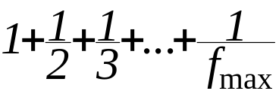
2. Network survivability
2.2. Heuristics
2H(f_{max})-approximation algorithm where H(f_{max}) =
is the harmonic function.
Goemans, Goldberg, Plotkin, Shmoys,
Tardos, Williamson (1996)
Factor 2 approximation algorithm when the function f is weakly supermodular
Jain (2001)
f(V)=0, and for every A,B ⊆ V at least one of the following holds:
- f(A)+f(B) ≤ f(A ∩ B)+ f(A ∪ B) or
f(A)+f(B) ≤ f(A\B)+ f(B\A).
If a function is proper then it is weakly supermodular.

Slide 40
2. Network survivability
2.2. Heuristics
Case when copies of edges are allowed
Jain’s algorithm also works when multiple copies of an edge are allowed: ⇒ factor 2 approximation algorithm
min{2r_{max},2p}-approximation algorithm
Goemans and Bertsimas (1993)
where p is the number of distinct connectivity requirement
values and r_{max} = max{r(u), v∈V}.
2 log r_{max}-approximation algorithm
Agrawal, Klein and Ravi (1995)
2H(f_{max})- approximation algorithm
Goemans & Williamson (1992)

Slide 41
2. Network survivability
2.3. Polyhedral results
2.3. Polyhedral Results
Let SNDP(G) be the convex hull of the solutions of SNDP, i.e.
SNDP(G) = conv{x ∈R^{E}| x is a (an integer) solution of SNDP}.
SNDP(G) is called the survivable network design polyhedron.

Slide 42
2. Network survivability
2.3. Polyhedral results
2.3.1. Restricted graphs
A graph is said to be series-parallel if it can be constructed from
an edge by iterative application of the following operations:
Addition of parallel edges
2) Subdivision of edges

Slide 43
2. Network survivability
2.3. Polyhedral results
Theorem: (Kerivin & M. (2002))
If G is series-parallel and r(v) is even for every v, then SNDP(G) is given by the trivial and the cut inequalities.
Generalizes Cornuéjols, Fonlupt and Naddef (1995), Baïou & M. (1996), Didi-Biha & M. (1999).
Corollary:
If G is series-parallel and r(v) is even for every v, then SNDP
can be solved in polynomial time.

Slide 44
2. Network survivability
2.3. Polyhedral results
k-Connectivity with k odd
Let (V₁,…,V_{p}) be a partition of V. Chopra (1994) showed that
x(δ(V₁,…,V_{p})) ≥⎡k/2⎤p-1
(1)
is valid for the SNDP(G) when G is outerplanar (a subclass of series-parallel graphs), k is odd and an edge can be used more than once. Here δ(V₁,...,V_{p}) is the set of edges between the V_{i}’s.
Theorem: Chopra (1994)
If G is outerplanar, k odd and multiple eges are allowed, then the
k-edge connected polyhedron is given by inequalities (1) and x(e) ≥ 0 for all e.
Generalized by Didi Biha & M. (1996) to series-parallel graphs (with and without possibility of multiple copies of edges) .

Slide 45
2. Network survivability
2.3. Polyhedral results
General graphs
Low connectivity case: r(v)∈{0,1,2}
2.4.2. Valid inequalities:
Trivial inequalities:
0 ≤ x(e) ≤ 0 for all e∈E
Cut inequalities:
x(δ(W) )≥ con(W) for all W⊂V, ∅ ≠ W≠V

Slide 46
2. Network survivability
2.3. Polyhedral results
Partition inequalities:
Let V₁,...,V_{p} , p ≥ 2, be a partition of V such that con(V_{i}) ≥ 1 for all V_{i}. Then the following inequality is valid for SNDP(G).
x(δ(V₁,...,V_{p})) ≥ p-1, if con(V_{i})=1 for all V_{i}
≥ p, if not,
(Grötschel, Monma and Stoer (1992))

Slide 47
2. Network survivability
2.3. Polyhedral results
F-partition inequalities:
Let V₀,V₁,...,V_{p} be a partition of V such that con (V_{i})=2 for all V_{i}
V
2
V
1
V
3
V
p
V
4
V
0

Slide 48
2. Network survivability
2.3. Polyhedral results
F-partition inequalities:
Let V₀,V₁,...,V_{p} be a partition of V such that con (V_{i})=2 for all V_{i}
V
2
Let F be a set of edges of δ(V₀)
and |F| id odd.
V
1
V
3
x(δ(V_{i}))≥2, i=1,…,p
V
p
V
4
-x(e) ≥ -1, e∈F
x(e) ≥ 0, e∈ δ(V₀)\ F
⇒ 2x(Δ) ≥ 2p-|F|,
V
0
Edges of
F
where Δ =δ(V₀,V₁,...,V_{p})\F

Slide 49
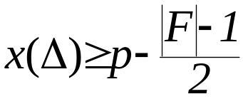
2. Network survivability
2.3. Polyhedral results
Then
is valid for the SNDP(G).
These inequalities are called F-partition inequalities. (M. (1994))
Further valid inequalities related to the traveling salesman polytope
have been given by Boyd & Hao (1994) for the 2-edge connected
subgraph polytope. And general valid inequalities for the SNDP have
been introduced by Grötschel, Monma and Stoer (1992)
(generalizing the F-partition inequalities).

Slide 50
2. Network survivability
2.4. Separation
2.4. Separation
Consider the constraints
x(δ(V₁,...,V_{p})) ≥ p-1.
called multicut inequalities.
These arise as valid inequalities in many connectivity problems.
The separation problem for these inequalities reduce to |E| min
cut problems Cunningham (1985) .
It can also be reduced to|V| min cut problems Barahona (1992).
Both algorithms provide the most violated inequality if there is any.

Slide 51
2. Network survivability
2.4. Separation
F-partition inequalities
(r(v) =2 for all node v)
Theorem. (Barahona, Baïou & M.) If F is fixed, then the separation of F-partition inequalities can be solved in polynomial time.
Let G'=(V',E') be the graph obtained by deleting the edges of F. Hence the F-partition inequalities can be written as
x(δ(V₀,...,V_{p}) ) ≥ p-(|F|-1)/2
where (V₀,...,V_{p}) is a partition of V’ such that for each edge
uv ∈ F, |{u ,v}∩(V₀)|=1.

Slide 52
2. Network survivability
2.4. Separation
There are 2^{|F|} possibilities for assigning these nodes.
For each possibility we contract the nodes that must be in V₀ and solve the separation problem for the inequalities.
x(δ(V₀,...,V_{p}) ) ≥ p-(|F|-1)/2
where |F| is fixed. These are partition inequalities, and hence the separation can be done in polynomial time.

Slide 53
2. Network survivability
2.4. Separation
Partition inequalities
These inequalities can be written as
x(δ(V₁,...,V_{p})) ≥ p-1, if con(V_{i})=1 for all V_{i}
≥ p, if not,
For any partition (V₁,...,V_{p}) of V.
If r(v)∈{0,1,2}, the separation problem is NP-hard (Grötcshel, Monma, Stoer (1992)).

Slide 54
2. Network survivability
2.4. Separation
Theorem: (Kerivin, M. (2002)) The separation of the partition inequalities when r(v)∈{1,2} for all v can be done in polynomial time.
The separation reduces to minimizing a submodular function. ( A function f: 2^{V} ----> R is said to be submodular if
f(A∪B) + f(A∩B) ≤ f(A) + f(B), for all A, B⊂V.
Recently Barahona and Kerivin (2004) showed that the problem
reduces to O(|V|⁴) minimum cut problems.

Slide 55
2. Network survivability
2.5. Critical extreme points
2.5. Critical extreme points
of the 2-edge connected subgraph polytope
(Fonlupt & M. (1999))
We suppose r(v)=2 for all v.
Consider the linear relaxation of the problem:
min
x(δ(W))≥ 2 for all W⊂V, ∅ ≠ W≠V
0≤x(e)≤1 for all e ∈ E.

Slide 56
2. Network survivability
2.5. Critical extreme points
2.5. Critical extreme points
of the 2-edge connected subgraph polytope
(Fonlupt & M. (1999))
We suppose r(v)=2 for all v.
Consider the linear relaxation of the problem:
min
x(δ(W))≥ 2 for all W⊂V, ∅ ≠ W≠V
P(G)
0≤x(e)≤1 for all e ∈ E.

Slide 57
2. Network survivability
2.5. Critical extreme points
Reduction Operations
Let x be a fractional extreme point of P(G).
O₁: delete edge e such that x(e)=0,
O₂: contract a node set W such that the subgraph induced by W, G(W) is 2-edge connected and x(e)=1 for every e∈E(W).
G
G'
W
is 2-edge connected
and x(e)=1 for every e∈E(W).
G(W)

Slide 58
2. Network survivability
2.5. Critical extreme points
O₃: contract an edge having one of its endnodes of degree 2.
u
v
z
u
z
G
G'
Lemma: Let x be an extreme point of P(G) and x’ and G’ obtained from x and G by applications of operations O₁, O₂, O₃. Then x’ is an extreme point of P(G’). Moreover if x violates a cut, a partition or an F-partition inequality, then x’ so does.

Slide 59
2. Network survivability
2.5. Critical extreme points
Domination
Let x and y be fractional two extreme points of P(G). Let F_{x}={e∈E | x(e) is fractional} and F_{y}={e∈E | y(e) is fractional}. We say that x dominates y if F_{y}⊂F_{x}.
Question:
Characterise the minimal fractional extreme points.

Slide 60
2. Network survivability
2.5. Critical extreme points
Definition : A fractional extreme point x of P(G) is said to be critical if:
1) none of the operations O₁, O₂, O₃ can be applied for it,
2) it does not dominate any fractional extreme point of P(G).
Example:
1/2
1/2
1
1
1/2
1/2
1
1
1
1/2
1/2
1/2
1/2
1/2
1/2
1
1
1
1/2
Non-critical
Critical

Slide 61
2. Network survivability
2.5. Critical extreme points
Definition : A fractional extreme point x of P(G) is said to be critical if:
1) none of the operations O₁, O₂, O₃ can be applied for it,
2) it does not domine any fractional extreme point of P(G).
Example:
1/2
1/2
1
1
1/2
1
1
1
1
1/2
1
1/2
1
1/2
1/2
1
1
1
Extreme point
1/2
Non-critical
Critical

Slide 62
2. Network survivability
2.5. Critical extreme points
Definition : A fractional extreme point x of P(G) is said to be critical if:
1) none of the operations O₁, O₂, O₃ can be applied for it,
2) it does not domine any fractional extreme point of P(G).
Example:
1/2
1/2
1
1/2
1
1
1
1
1/2
1/2
1/2
1/2
1
1
1
Extreme point
1/2
Critical
Critical

Slide 63
2. Network survivability
2.5. Critical extreme points
Theorem: An extreme point of P(G) is critical if and only if
G and x are of the following form:
1/2
1/2
1
1/2
|C|+1
1
⇒
Σ
x(e) ≥
1
1
forest
e∈C
2
1/2
1
1/2
1
1
is valid and defines a facet
G
1/2
1/2
Odd cycle C
(it is an F-partition inequality)

Slide 64
2. Network survivability
2.5. Critical extreme points
Theorem: If x is a critical extreme point of P(G), then x can be separated (in polynomial time) by an F-partition inequality.
The concept of critical extreme points has been extended (with respect to appropriate reduction operations ) to 2-node connected graphs and (1,2)-survivable networks (Kerivin, M., Nocq (2001)),
And to k-edge connected graphs (Didi Biha & M. (2004)).

Slide 65
2. Network survivability
2.6. Branch&Cut algorithm
2.6. Branch&Cut algorithm
(Kerivin, Nocq, M. (2001))
r(v)∈{1,2} for all v
Used constraints:
trivial inequalities
cut inequalities
F-partition inequalities
partition inequalities

Slide 66
2. Network survivability
2.6. Branch&Cut algorithm
If x is a fractional extreme point (critical or not), we apply the reduction operations. Let G’ and x’ be the graph and the solution thus obtained.
If a cut, a partition or an F-partition constraint is violated by x’ for G’, then it can be lifted to a constraint of the same type violated by x for G.

Slide 67
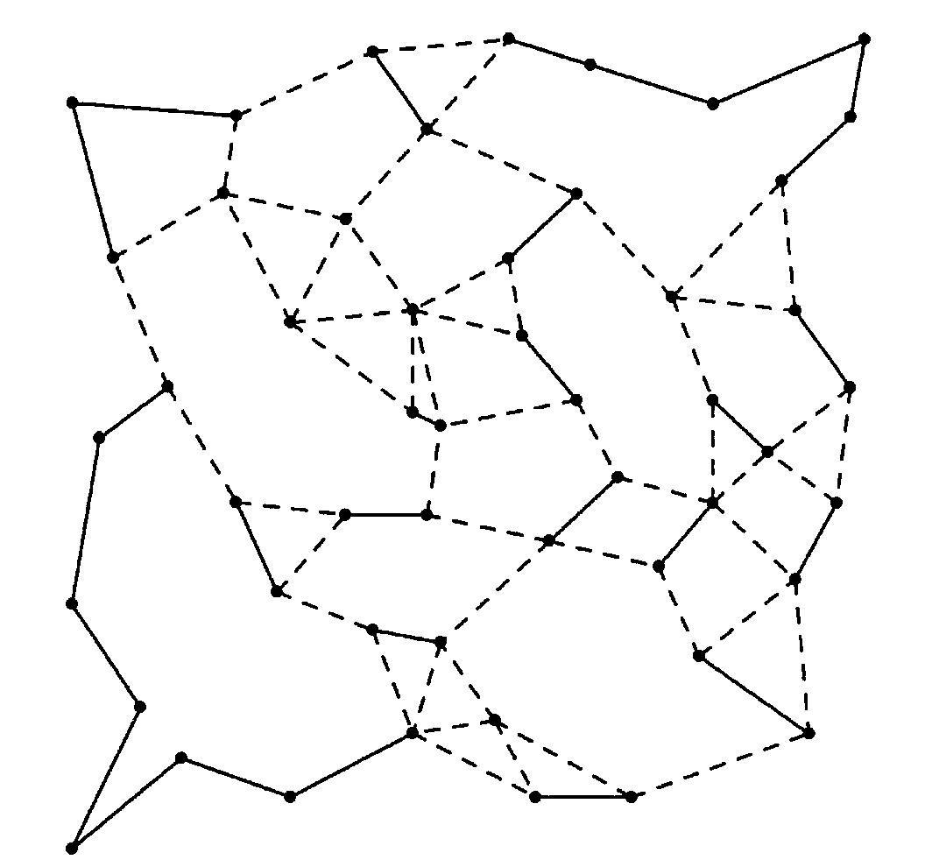
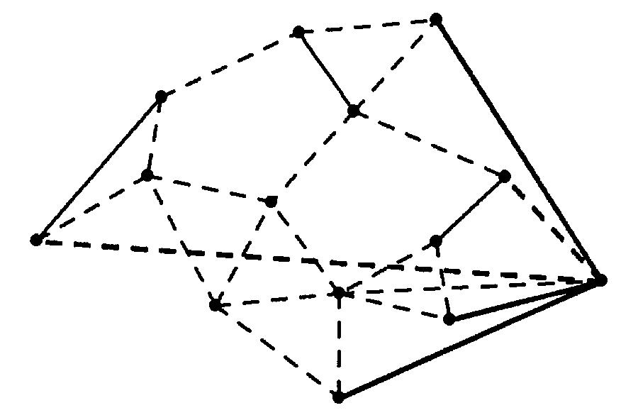
2. Network survivability
2.6. Branch&Cut algorithm
F
G’ 14 nodes
x(δ(V₁,…,V_{p})\F)≥11
G 51 nodes
This contraint cuts the extreme point of G’ and that of G.

Slide 68
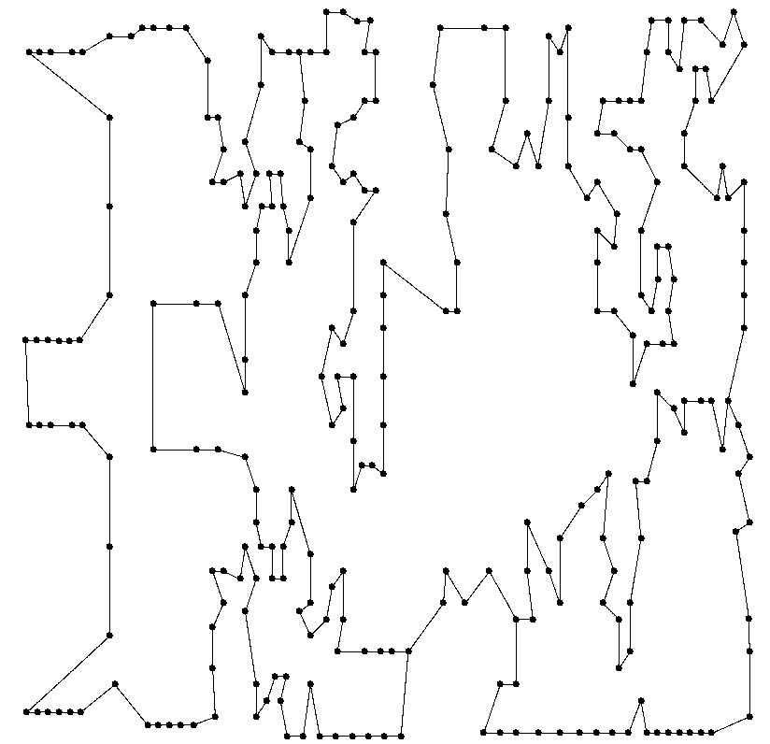
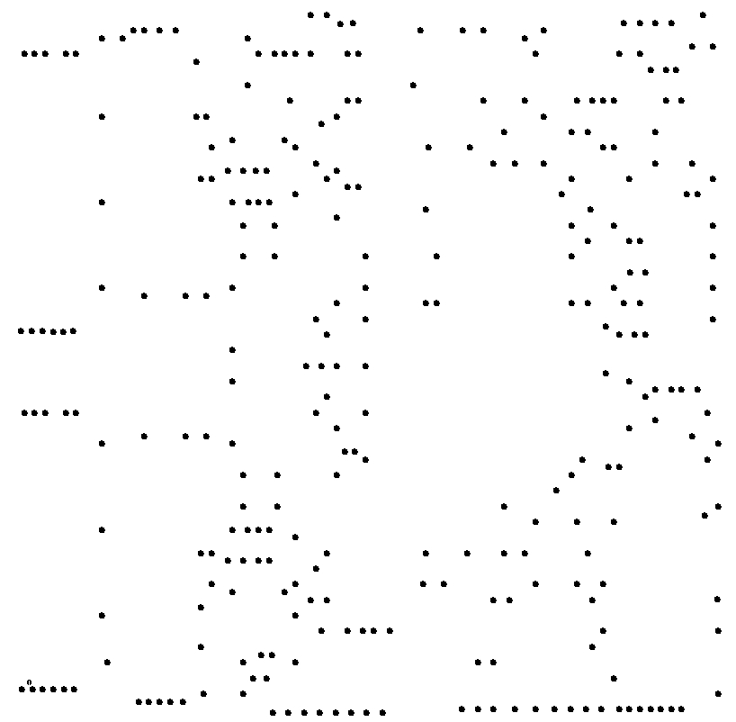
2. Network survivability
2.6. Branch&Cut algorithm
#nodes 299
(type 2)
#variables 44551
#constraints 357
CPU Time 142 sec

Slide 69
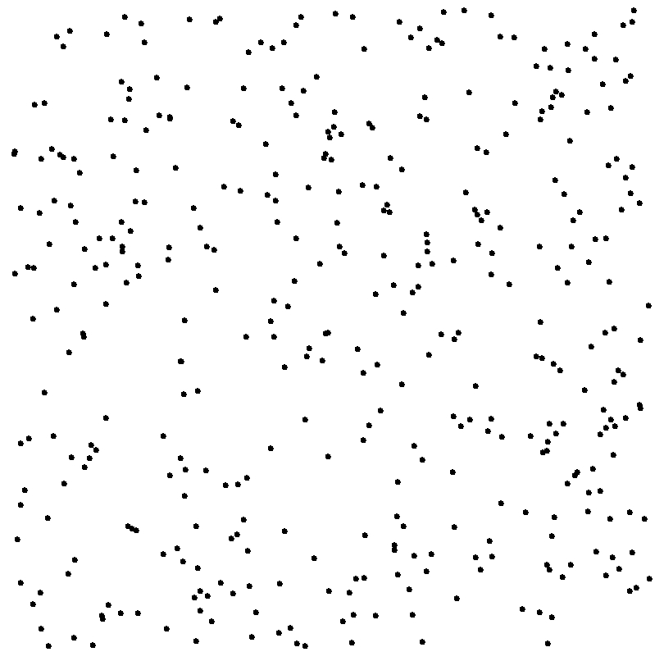
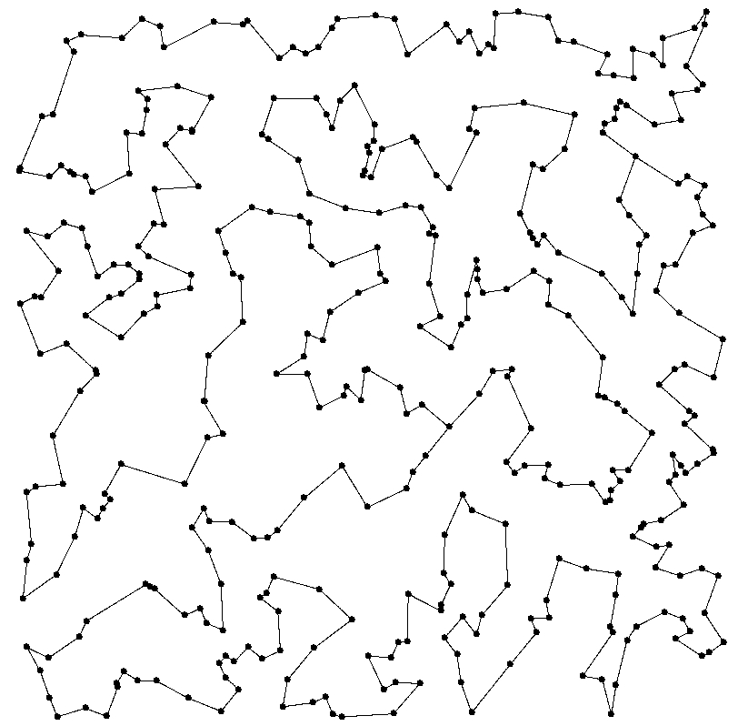
2. Network survivability
2.6. Branch&Cut algorithm
#nodes 400
(type 2)
2-node connected
#variables 79400
#constraints 1369
CPU Time 152 min

Slide 70
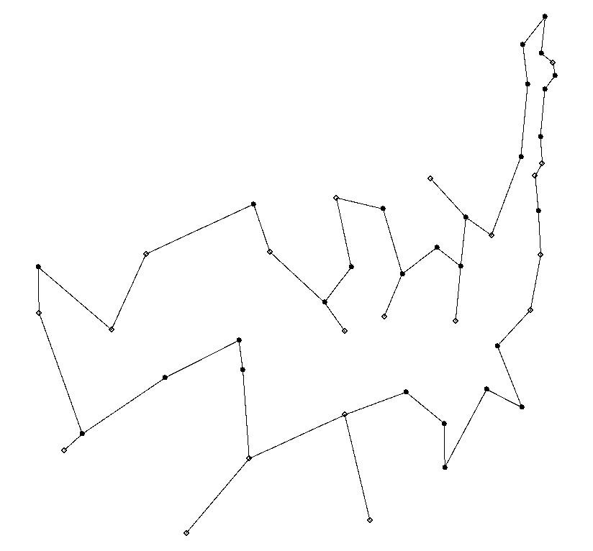
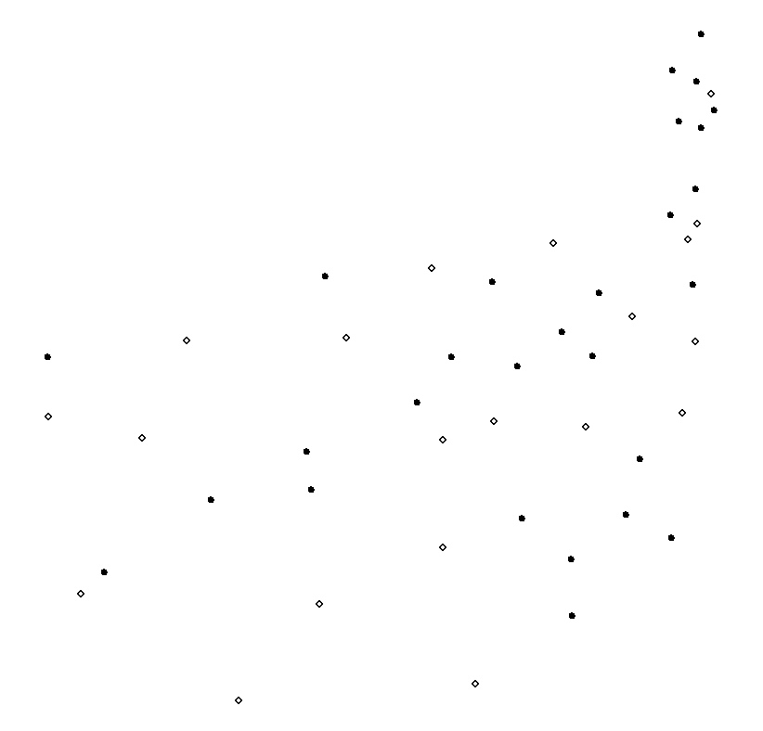
2. Network survivability
2.6. Branch&Cut algorithm
#nodes 48
#type 1 20
#type 2 28
#variables 1 128
#constraints 428
CpuTime 202 sec

Slide 71
2. Network survivability
2.7. Length constraints
2.7. Survivable networks with length constraints
Motivation: to have effective routing cost
Local rerouting:
Each edge must belong to a bounded cycle (ring).
SONET/SDH networks
End-to-end rerouting:
the paths between the terminals should not exceed
a certain length (a certain number of hops) (hop-constrained paths).
ATM networks, INTERNET

Slide 72
2. Network survivability
2.7. Length constraints
2.7.1. Bounded rings
2-node connected graphs
Fortz, Labbé, Maffioli (1999)
Fortz, Labbé (2002)
Valid inequalities
Separation algorithms
Lower bounds on the optimal value
Cutting plane algorithms
2-edge connected graphs
Fortz, M., McCormick, Pesneau (2003)

Slide 73
2. Network survivability
2.7. Length constraints
2.7.2. Hop-constrained paths
The minimum hop constrained spanning tree problem
Determine a minimum spanning tree such that the number of links between a root node and any node in the tree does not exceed a bound L.
(NP-hard (even for L=2))
Multicommodity flow formulation
Lagrangean relaxations
Gouveia (1998)
Gouveia & Requejo (2001)
Gouveia & Magnanti (2000)

Slide 74
2. Network survivability
2.7. Length constraints
The minimum hop-constrained path problem
Determine a minimum path between two given nodes s and t, of length no more than L (L fixed).
Dahl & Gouveia (2001)
Formulation in the natural space of variables
Valid inequalities
Description of the associated polytope when L=2,3.

Slide 75
2. Network survivability
2.7. Length constraints
The L-star inequalities (Dahl (1999))
Let V₀,V₁,...,V_{L+1} be a partition of V such that s∈ V₀ and t ∈V_{L+1}.
s
t
V
0
V
1
V
2
V
3
V
L+1
T

Slide 76
2. Network survivability
2.7. Length constraints
The L-star inequalities (Dahl (1999))
Let V₀,V₁,...,V_{L+1} be a partition of V such that s∈ V₀ and t ∈V_{L+1}.
s
t
V
0
V
1
V
2
V
3
V
L+1

Slide 77
2. Network survivability
2.7. Length constraints
The L-star inequalities (Dahl (1999))
Let V₀,V₁,...,V_{L+1} be a partition of V such that s∈V₀ and t ∈V_{L+1}.
x(T)≥1
s
t
(L-star inequalities)
V
0
V
1
V
2
V
3
V
L+1
T

Slide 78
2. Network survivability
2.7. Length constraints
Theorem: (Dahl (1999))
The L-star inequalities together with the cut inequalities (separating s and t) and the trivial inequalities completely describe the L-path polyhedron when L≤3.
If at least K paths are required between s and t, then
x(T)≥K
is valid for the corresponding polytope.
The separation problem for the L-star inequalities
can be solved in polynomial time, if L ≤ 3.
Fortz, M., McCormick, Pesneau (2003)

Slide 79
2. Network survivability
2.7. Length constraints
The hop-constrained network design problem (HCNDP):
Given a graph with weights on the edges, a set of terminal- pairs (origines-destinations), two intgers K, L, find a minimum weight subgraph such that between each pair of terminals there are at least K paths of length no more than L.
K=1, L=2
(Dahl, Johannessen (2000)
Formulation of the problem
Valid inequalities
Greedy approximation algorithms
Cutting plane algorithm

Slide 80
2. Network survivability
2.7. Length constraints
K=2, L=3, and only one pair of terminals
Huygens, M., Pesneau (2003)
Formulation of the problem
Complete description of the associated polytope by
the trivial, the cut and the L-star inequalities
a polynomial time cutting plane algorithm for the problem (when K=2, L=3 )
⇒
No formulation (using the design variables) is known for the
problem when K = 2 and L = 4.

Slide 81
2. Network survivability
2.7. Length constraints
Length constrained 2-connected graphs
Ben Ameur (2000)
Classes of length constrained 2-connected graph
Lower bounds on the number of edges
Valid inequalities for the 2-connected polytope with
length constraints

Slide 82
2. Network survivability
2.8. Capacitated networks
2.8. Capacitated Survivable Networks
Given
- a graph G=(V,E) (the supply graph) ,
- a set of demands {d_{uv}} between pairs of origines-destinations (u,v),
- a set {C_{e}^{t}, t=1,…,T_{e}} of discrete capacities, specified for each edge e
- a cost K_{e}^{t} for each capacity C_{e}^{t},
- for every demand d_{uv}, a parameter 0<ρ_{uv}<1 representing the fraction
of demand d_{uv} that must be satisfied if an edge (or a node) fails.
The problem:
Stoer & Dahl (1994)
Which capacities to install on the edges such that for every
single edge (or node) failure, at least the fraction ρ_{uv} of d_{uv} can
be routed for every demand d_{uv}, and the total cost is minimum.

Slide 83
2. Network survivability
2.8. Capacitated networks
Stoer & Dahl (1994, 1998) proposed
- a mixed integer programming formulation,
- valid and facet defining inequalities (some of the inequalities
obtained by exploiting the knapsack structure of some
subsystems) and the 2-connected topology,
- a cutting plane algorithm.
A more general model with path length and routing constraints
Alevras, Grötschel, Wessäly (1997, 1998)
Mixed integer programming formulation
Cutting plane algorithms

Slide 84
2. Network survivability
2.8. Capacitated networks
Cut subsystem
Let C be a cut. Usually inequalities of the following form are valid.
Σ
(1)
Demand inequality
x(e) ≥D
e∈C
Σ
(2)
Survivability inequalities
x(f) ≥L, e∈C
f∈C\{e}
x(e)∈ Z₊ , e∈C (3)
Let P_{n}(D,L) (|C|=n) be the polyhedron given by (1)-(3).

Slide 85
2. Network survivability
2.8. Capacitated networks
P_{n}(D,L) (and some extensions) have been studied by
Bienstock and Muratore (1997)
Muratore (1998)
- Structural properties of the extreme points of P_{n}(D,L)
- Description of valid and facet defining inequalities
- Development of cutting plane algorithm for solving capacitated
SNDP.
Magnanti & Wang (1997) studied the same polyhedron but without constraint (1) (capacity constraint) and with different right hand sides for the survivability inequalities.

Slide 86
Conclusion
- The Survivable network design problems are difficult to
solve (even special cases).
- The problems with length constraints remain the most
complicated SNDP . A better knowledge of their facial structure would be usefull to establish efficient cutting plane techniques.
The capacitated SNDP needs more investigation, from both the
algorithmic and polyhedral points of view.
Develop usefull cutting plane and column generation techniques for the very general model with length constraints, capacity assignment and routing….?

